Slide 1
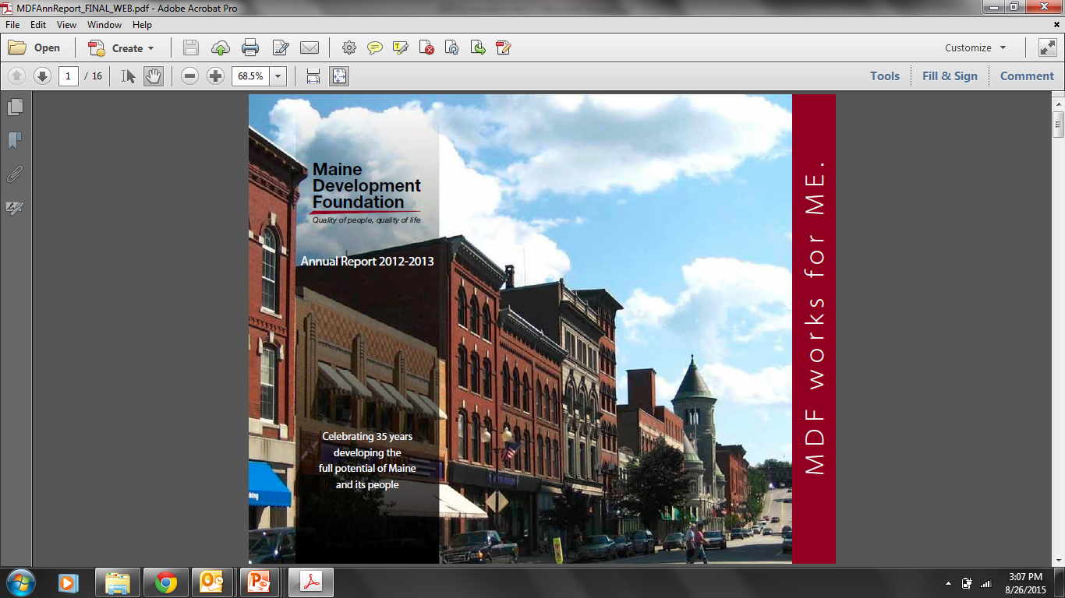
Yellow Light Breen, President & CEO
“Leading for Growth and the Quest for Talent”
Maine Educational Opportunity Association, 7 January 2019

Slide 2


Slide 3
Maine Economic Context
Requires Brutal Honesty, Unquenchable Optimism

Slide 4
First, the good news…

Slide 5
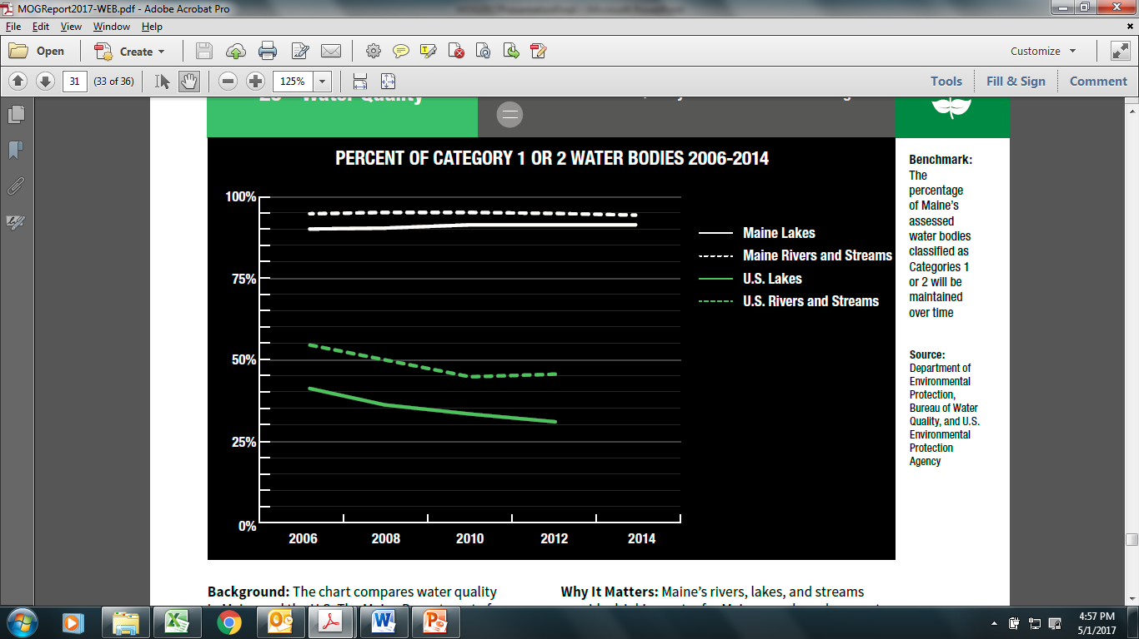
Source: Maine DEP Bureau of Water Quality, U.S. Environmental Protection Agency

Slide 6
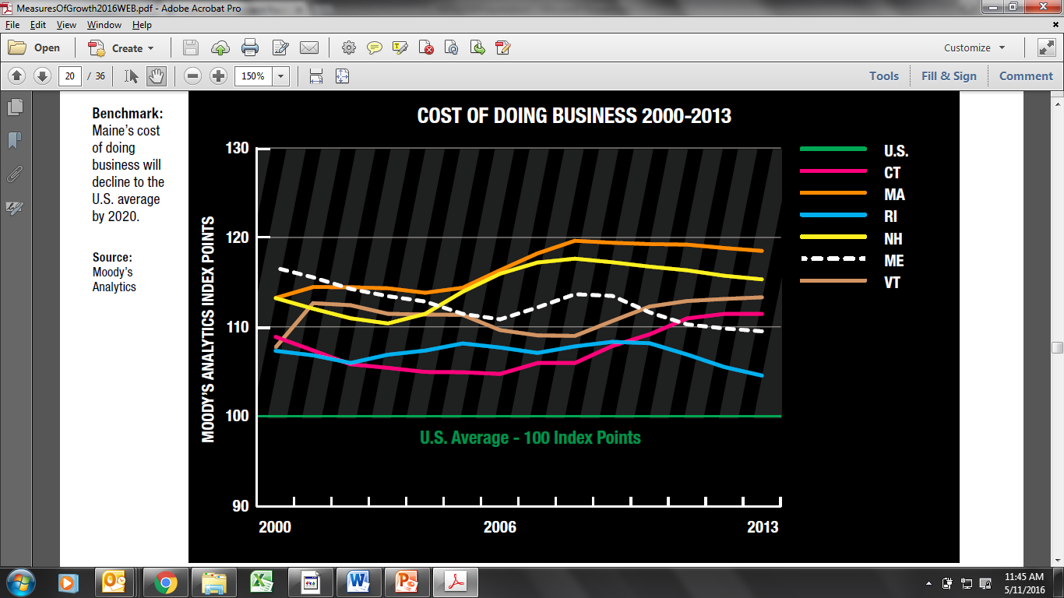
Source: Moody’s Analytics

Slide 7
Now, the brutal honesty…

Slide 8
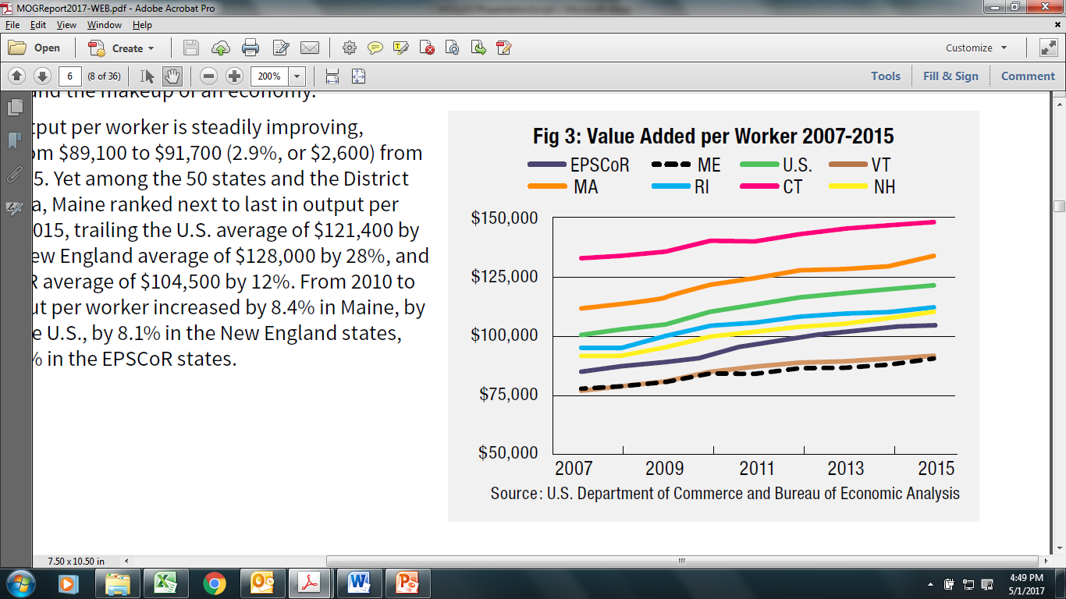

Slide 9
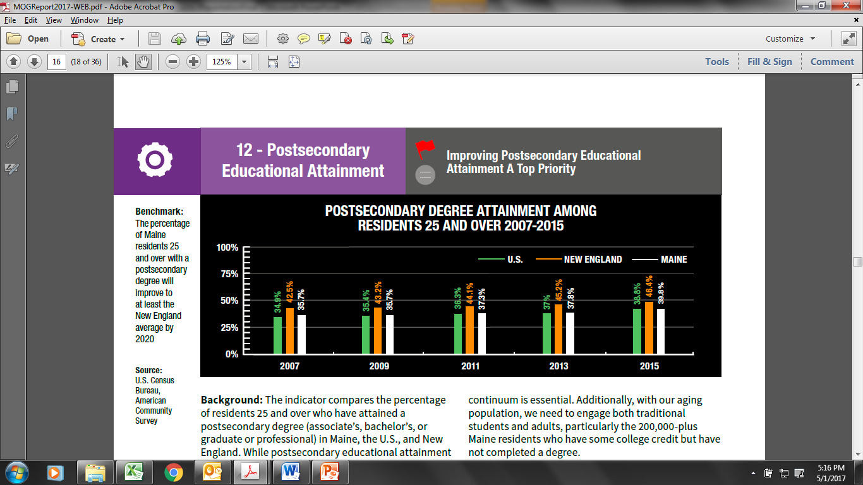
Source: U.S. Census Bureau, American Community Survey

Slide 10
For the first time in over 100 years,
Maine has more deaths than births

Slide 11
Nearly all growth expected in 65 and over cohort
U.S. Working Age: +7%
ME Working Age: -16%
U.S. 65 and over: +66%
ME 65 and over: +57%

Slide 12
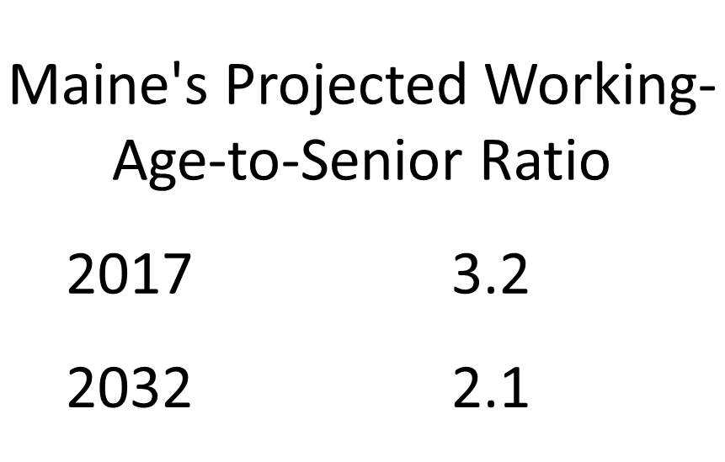

Slide 13
Attract, Build & Retain
Talent for Maine

Slide 14
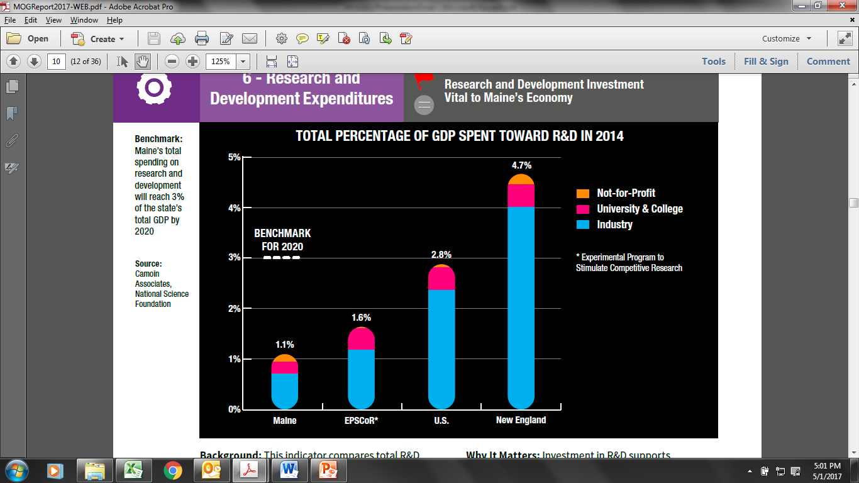
Source: Camoin Associates, National Science Foundation

Slide 15
Create a Climate for
Investment & Innovation in Maine

Slide 16









Slide 17
Trusted Research
Leadership
Creative Cross-Sector Partnerships

Slide 18
“Recognition is an accelerant of change.”

Slide 19
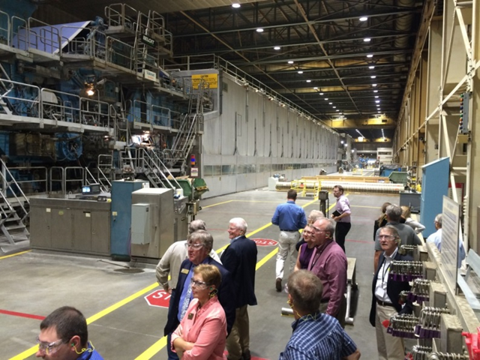

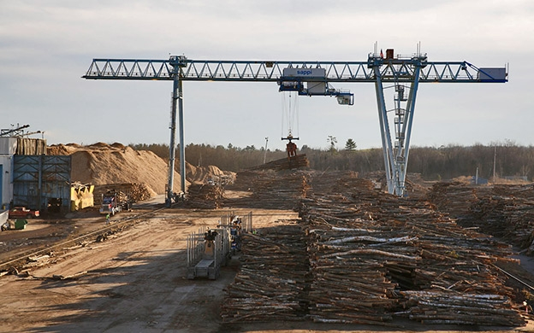

Slide 20
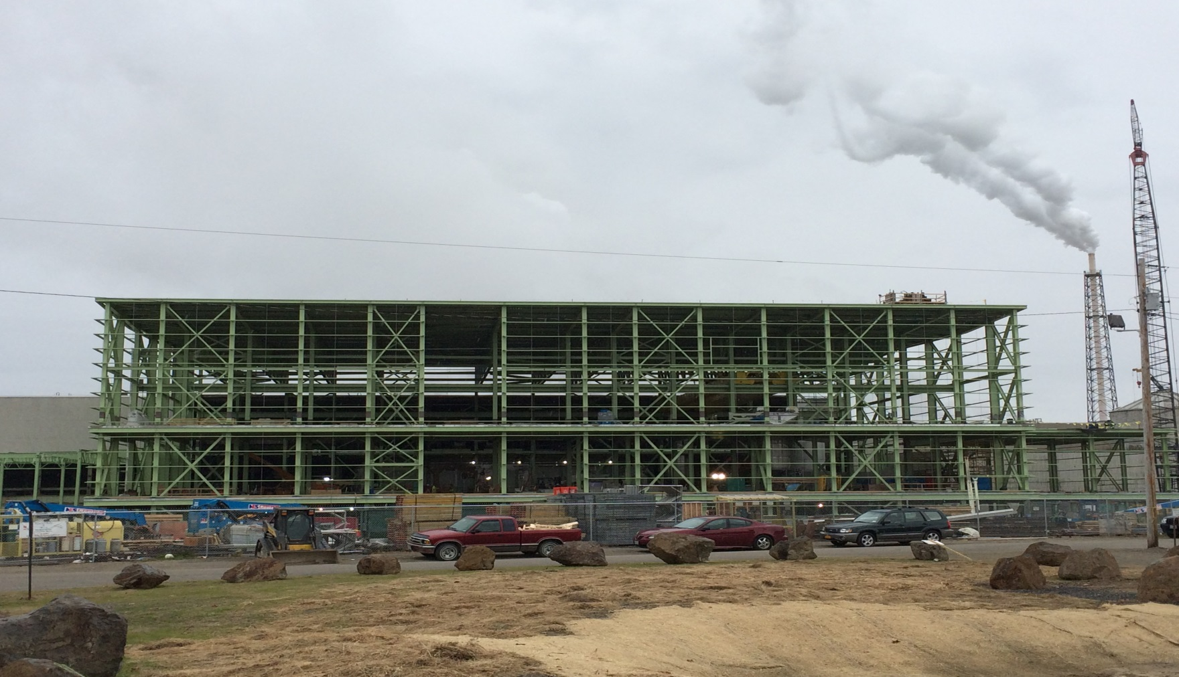

Slide 21

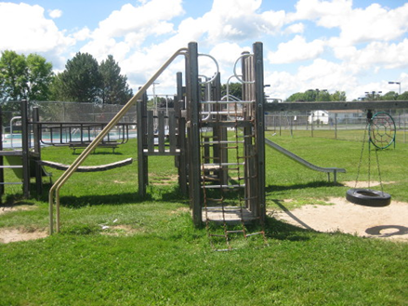
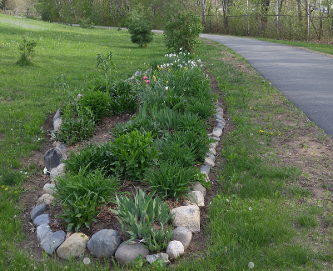
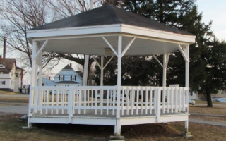
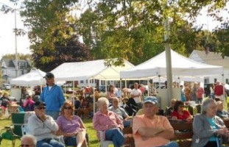
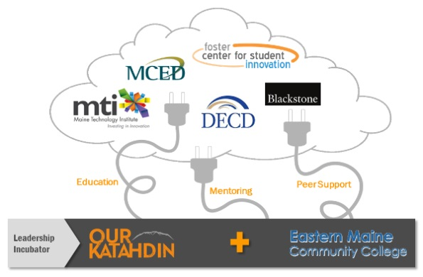

Slide 22

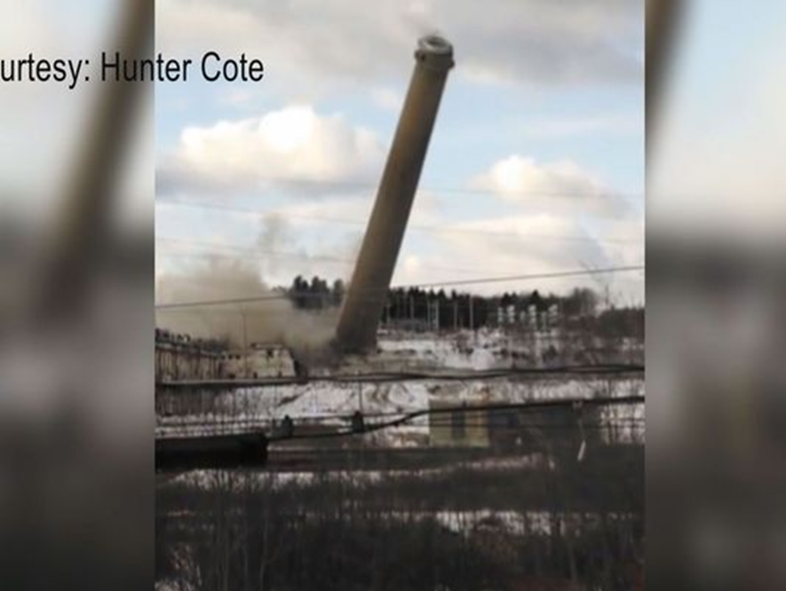
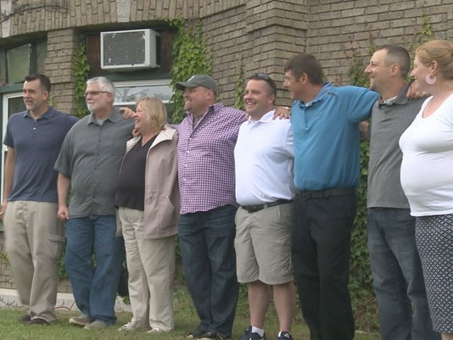
“Our Katahdin purchases site of former Millinocket mill”

Slide 23
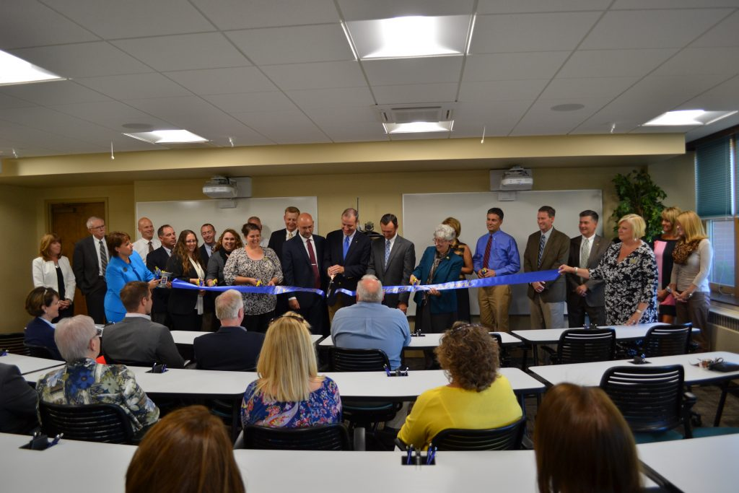

MMG Center for Professional Development - UMPI

Slide 24
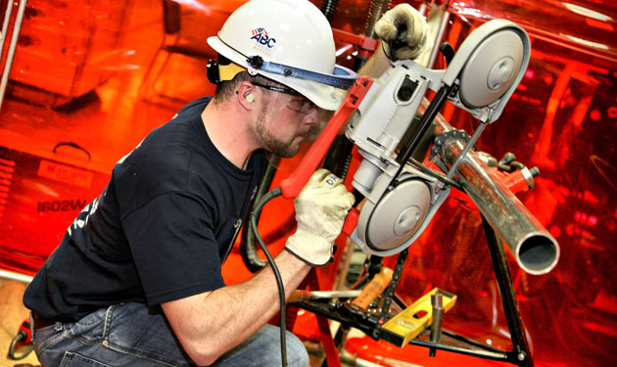

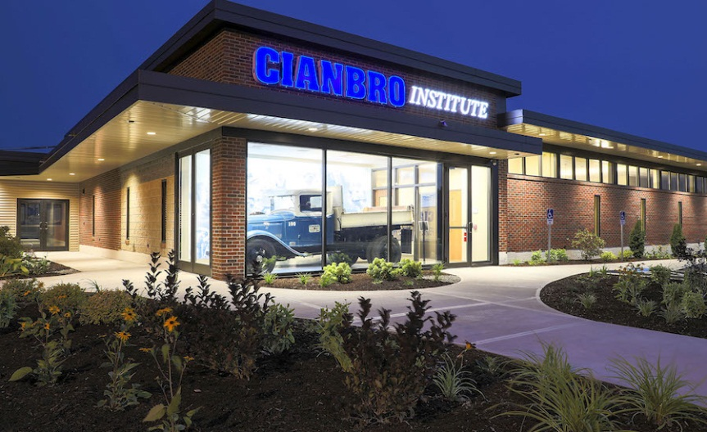
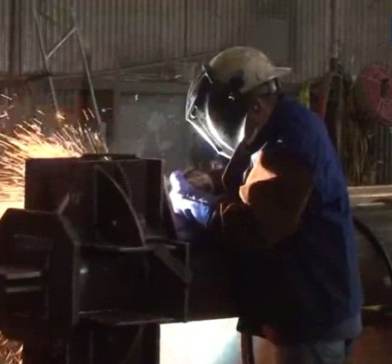
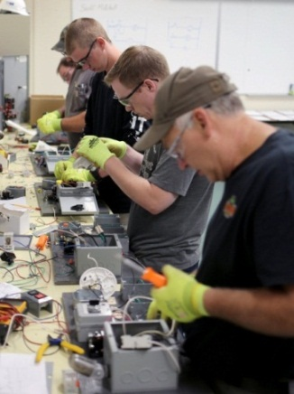

Slide 25

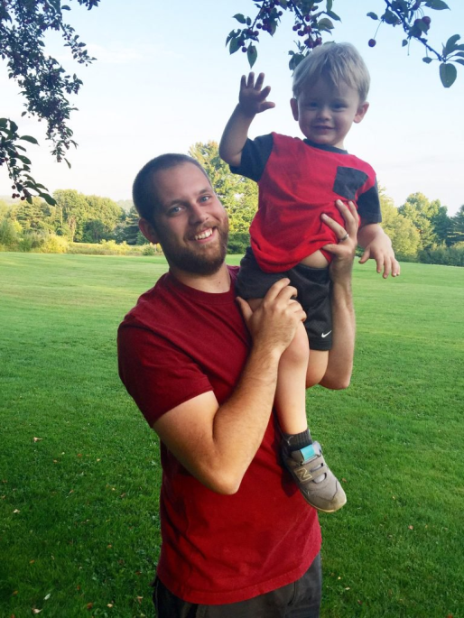


Alfond Foundation pays off $685,000 in student loan debt for 20 Maine graduates
The funds are the first round of payments in a program intended to eliminate $5 million in debt for Maine residents working in STEM fields.
“It gives us hope for the future.”

Slide 26

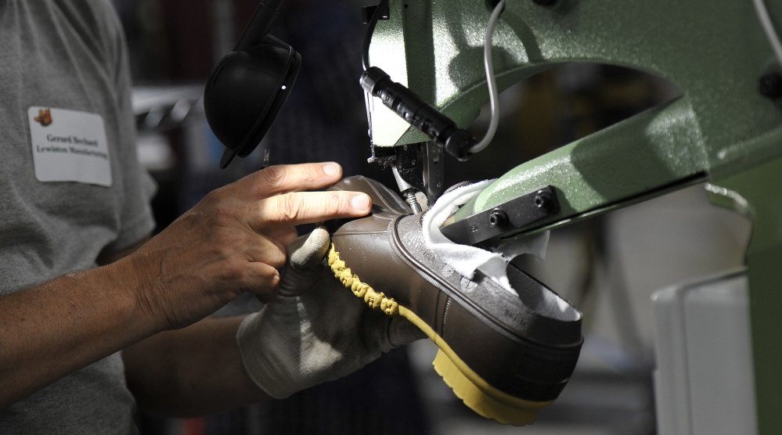

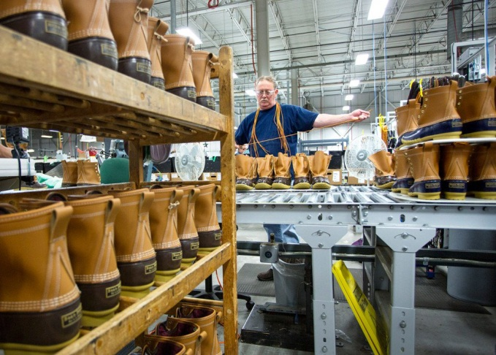

Slide 27
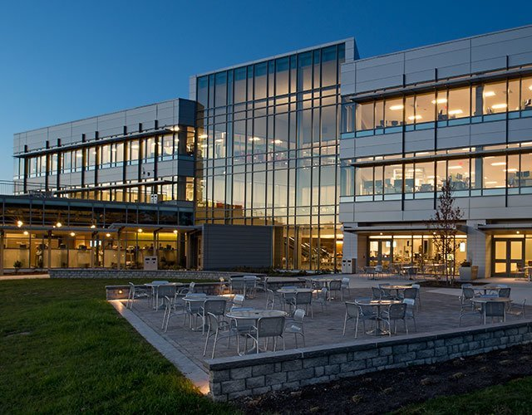

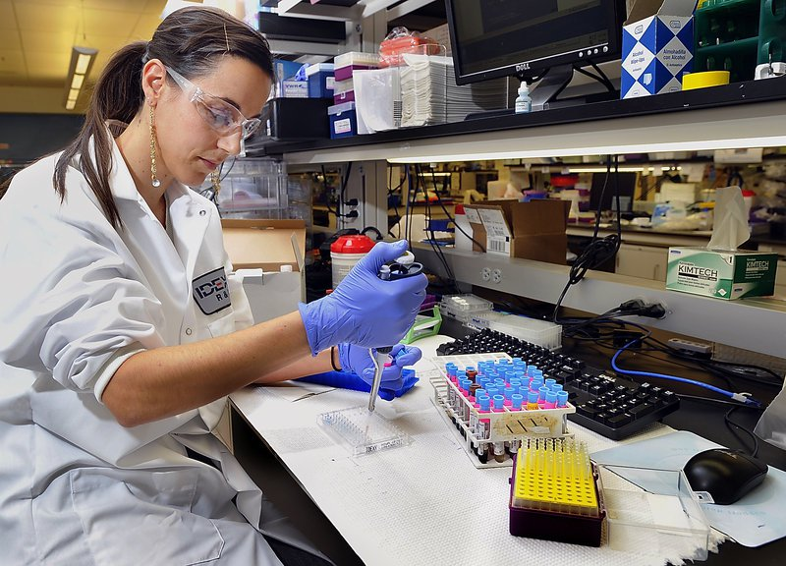

Slide 28

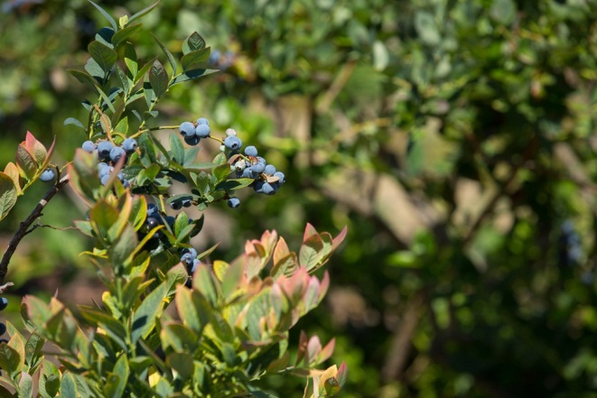

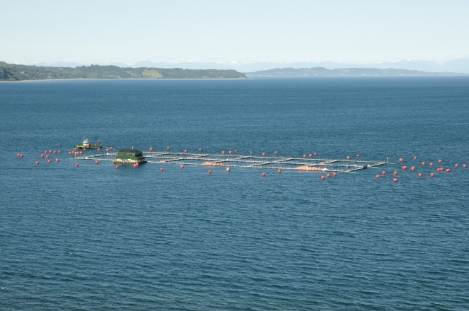
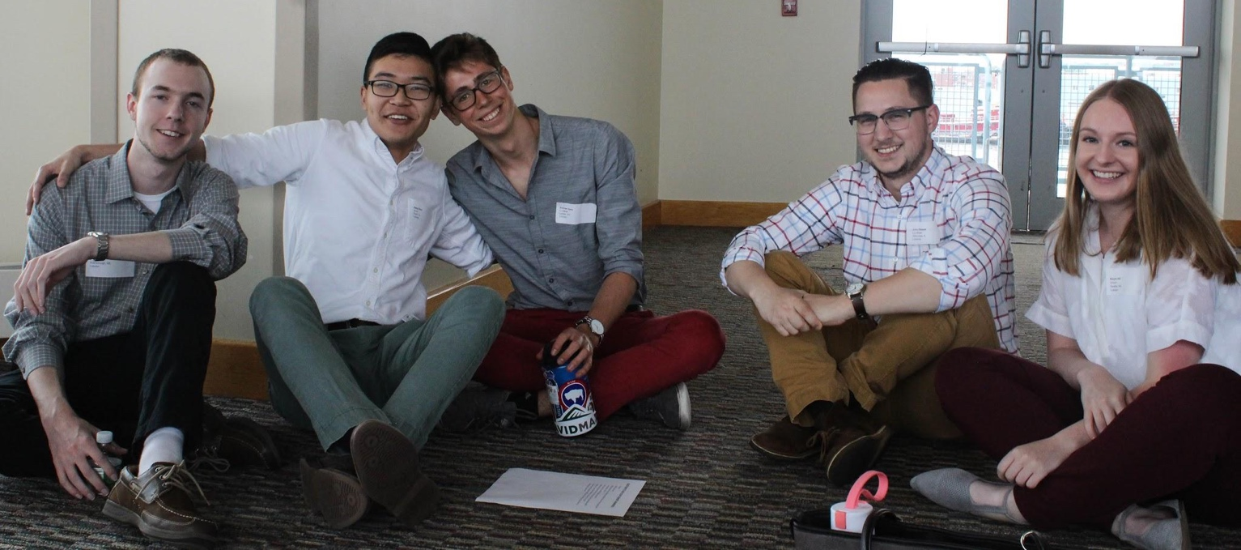

Slide 29
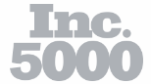


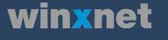
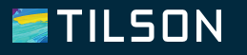

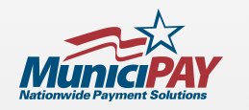




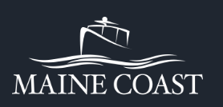


Slide 31
Trusted Research
Leadership
Creative Cross-Sector Partnerships

Slide 32
Unleash the Potential of Maine People

Slide 33

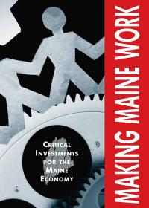




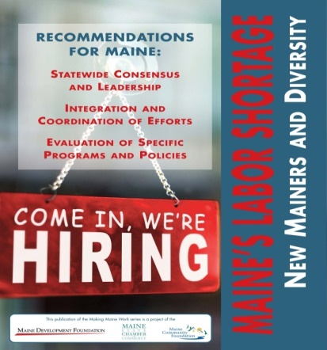

Slide 34
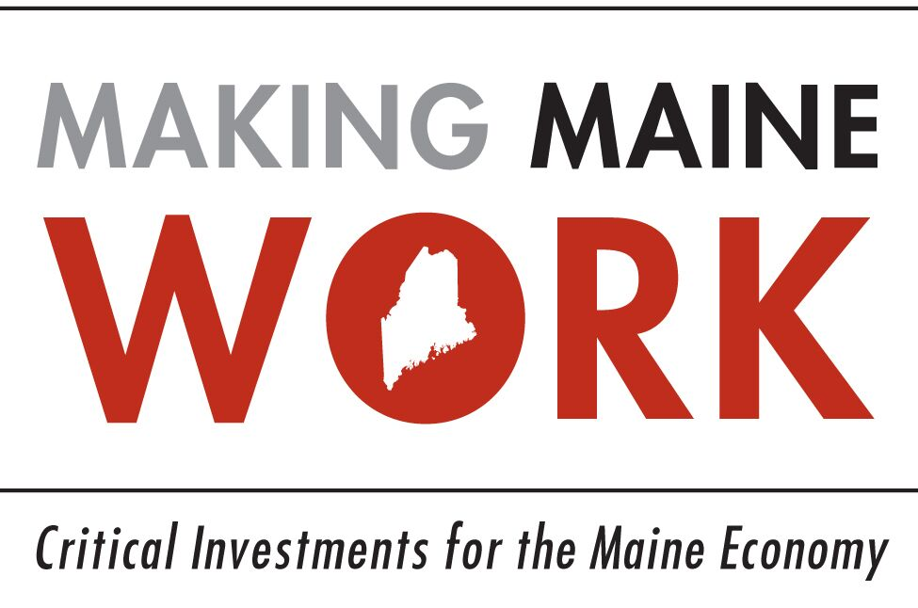


Slide 35
What do you think are the key factors
that support business retention
and expansion in Maine?
Key Factor Percentage
Quality of Life 53%
Quality of Workforce 36%
Natural Resources, Climate and Environment 25%
Business Economy 16%
Education and Educational Resources 15%
Space for Growing Population 11%
Favorable Tax Policies (General) 10%
Government and Policies (General) 9%
Supportive and Engaged Community 8%
Funding and Capital 7%
Location/Access to Larger Markets (Boston/Canada) 6%
Multiple responses accepted; only categories with >5% shown (n=777). Source: Survey of Maine Business and Education Leaders by Market Decisions Research; March 2018

Slide 36
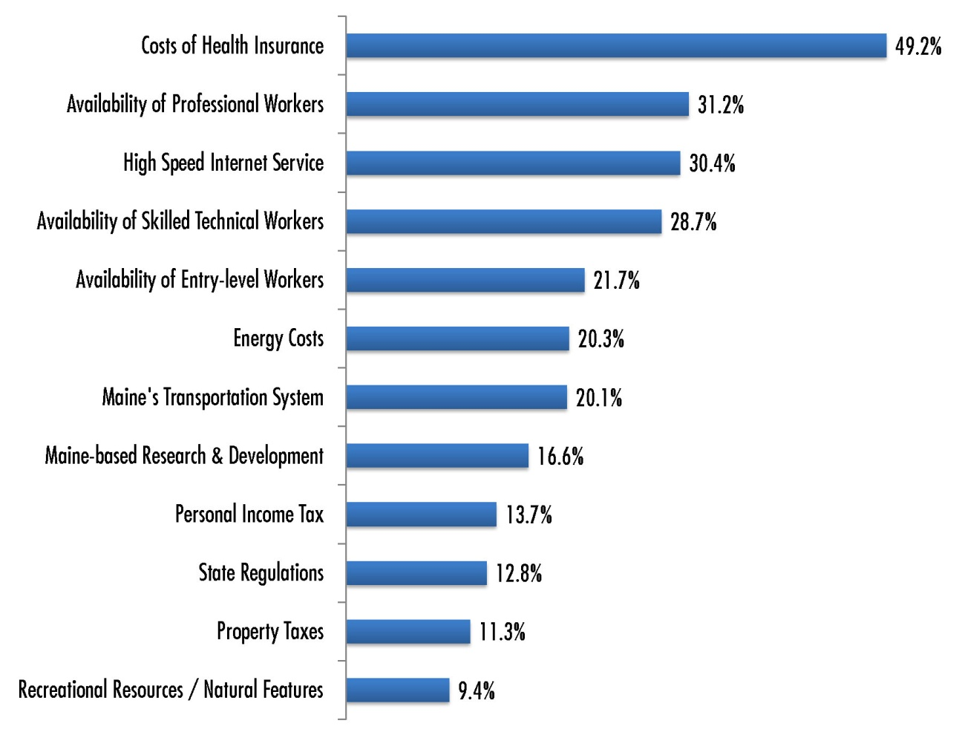
Top 12 Issues for Maine’s Next Governor & Legislature
Source: Survey of Maine Business and Education Leaders by Market Decisions Research; March 2018

Slide 37
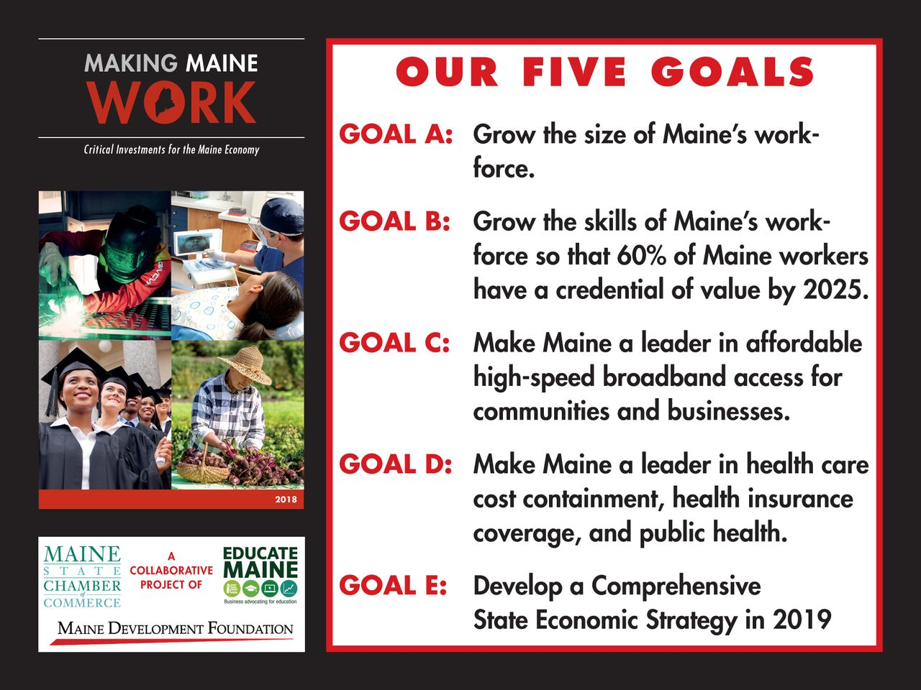

Slide 38
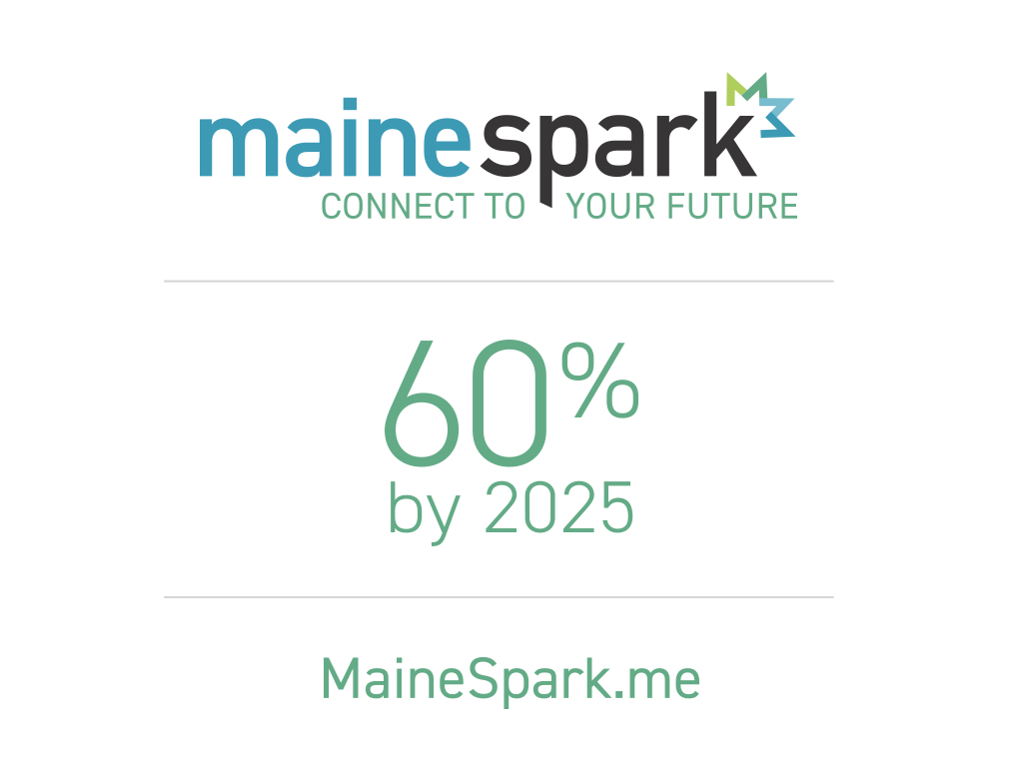

Slide 39
#BHAG

Slide 40
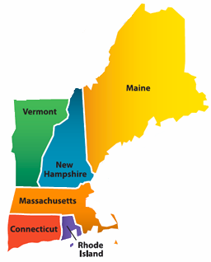
New England
Attainment Goals
75%
65%
60%
70%
60%

Slide 41
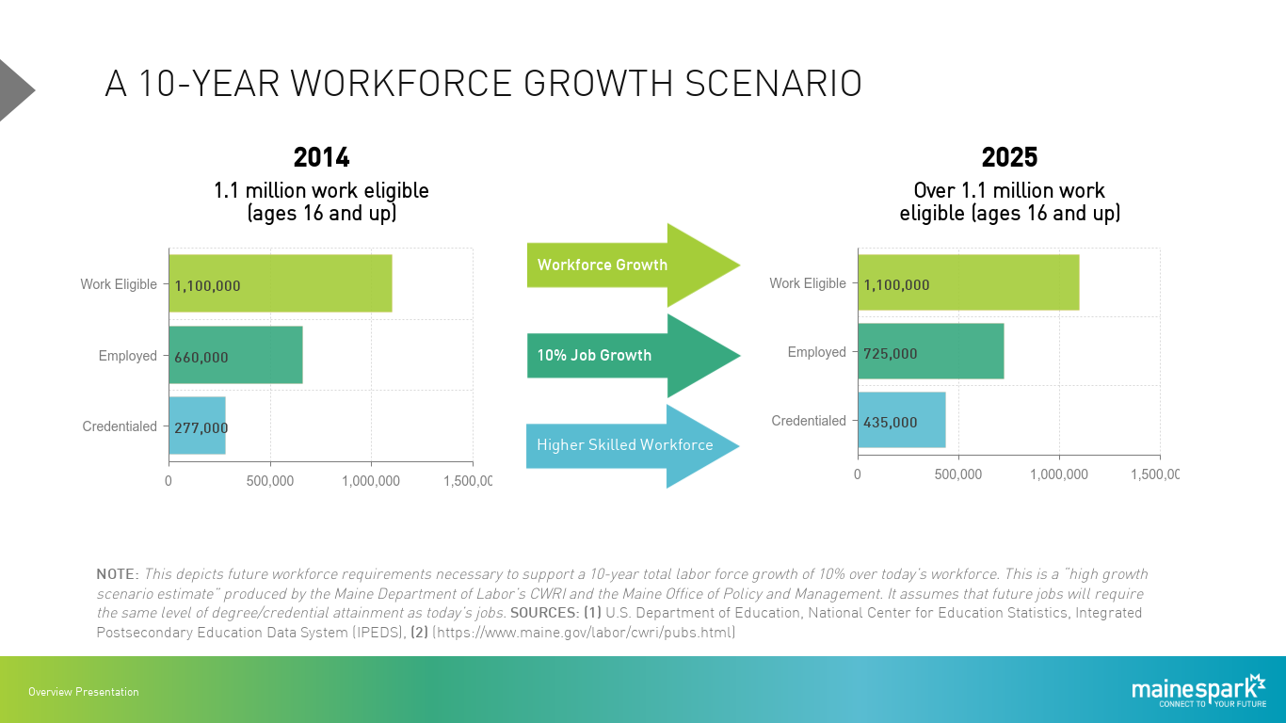

Slide 42
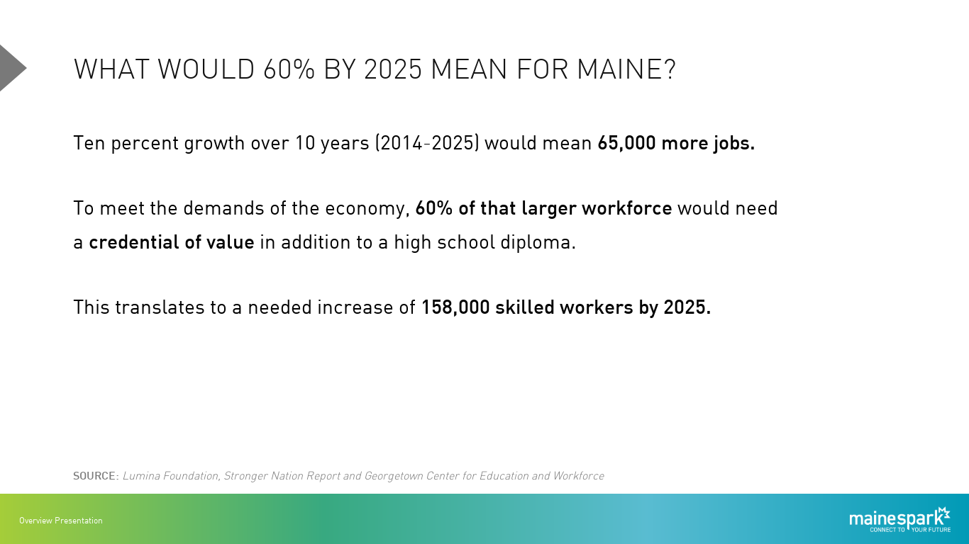

Slide 43
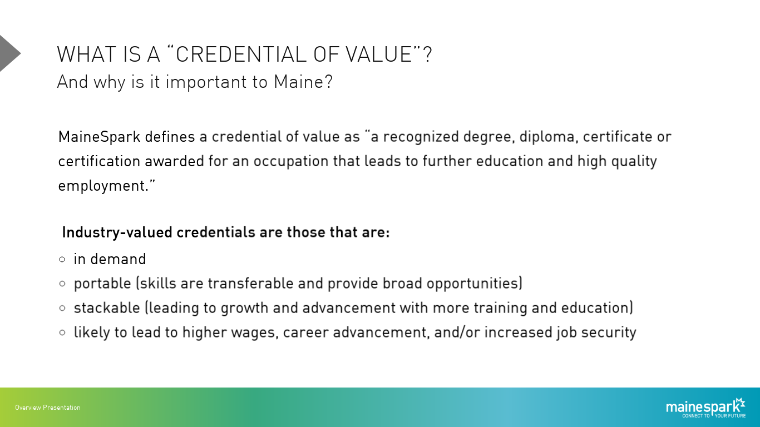

Slide 44




Maine’s Workforce and Education Coalition

Slide 45
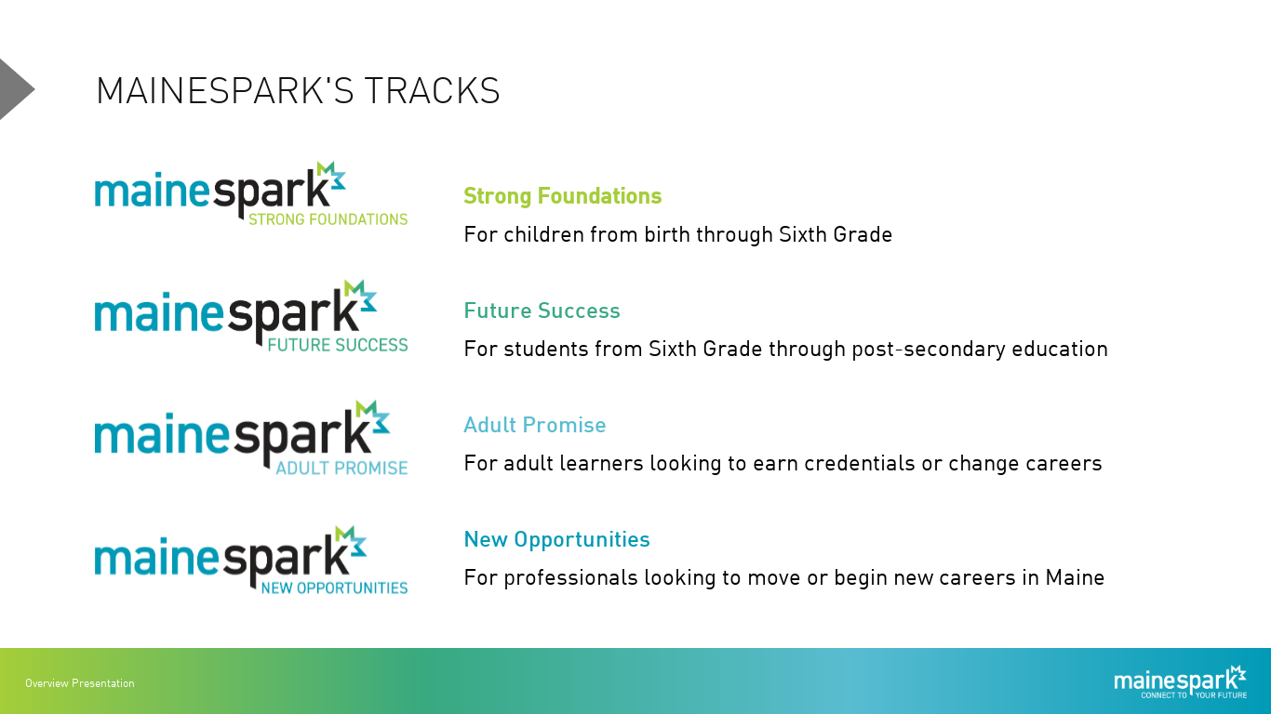

Slide 46
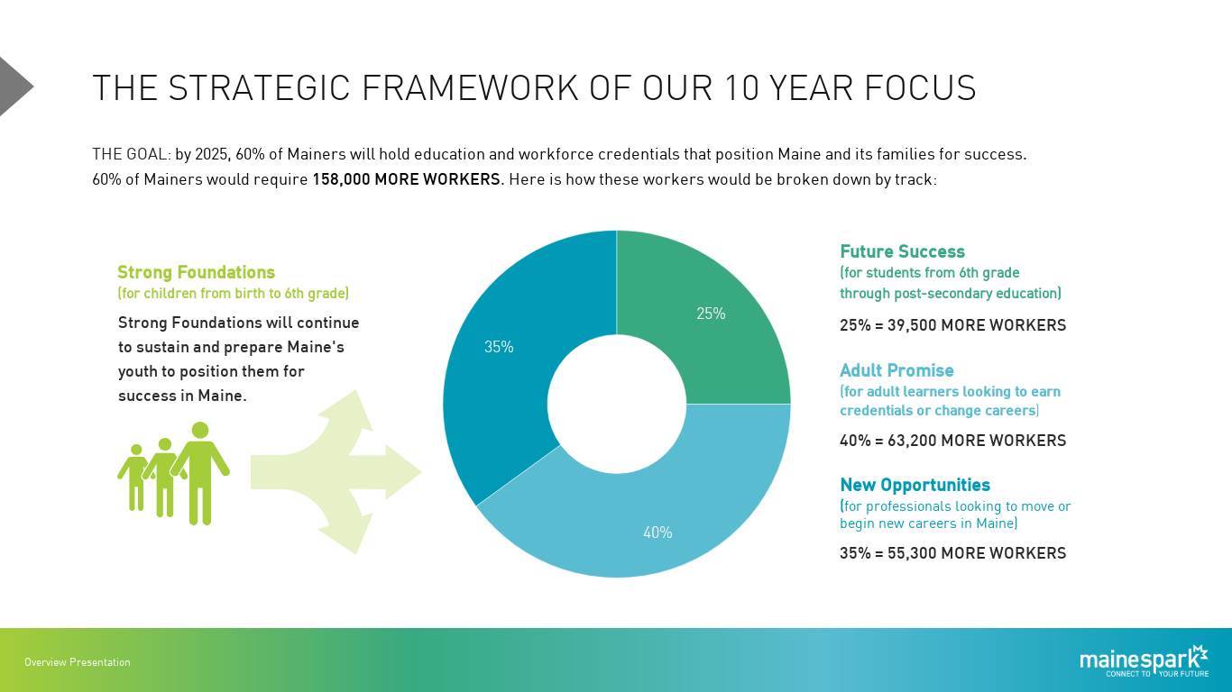

Slide 47
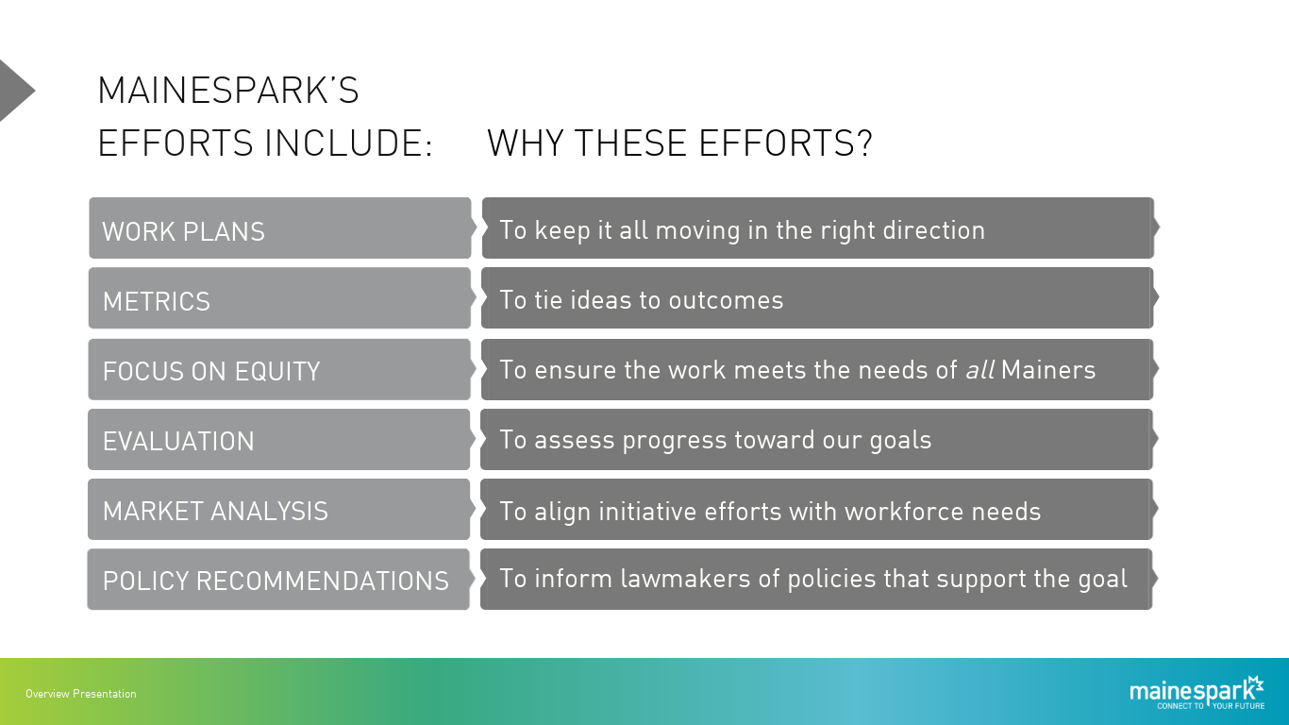

Slide 48
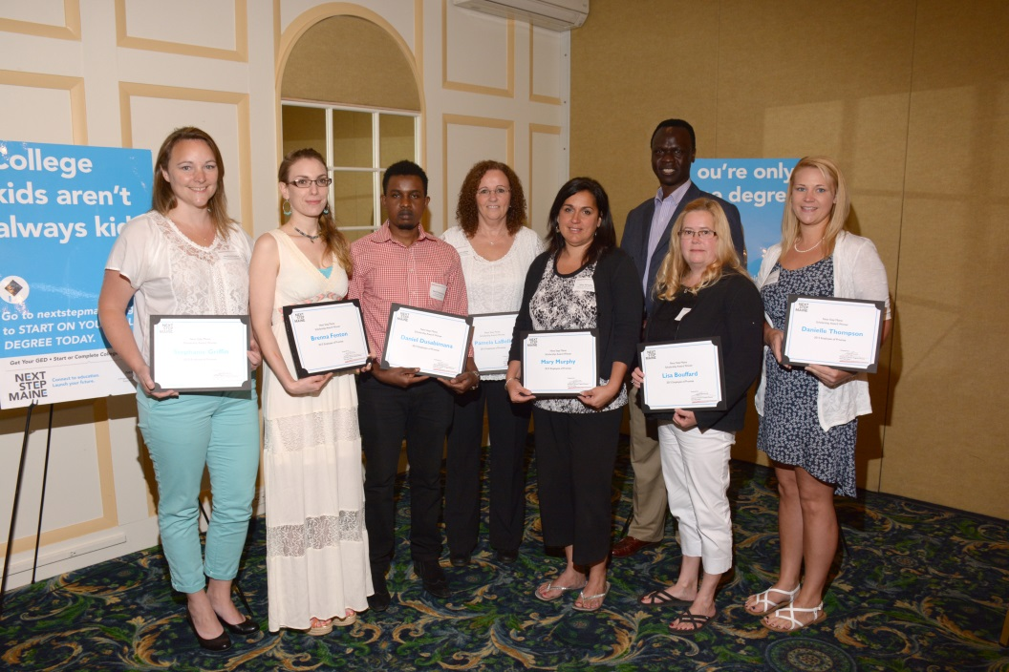
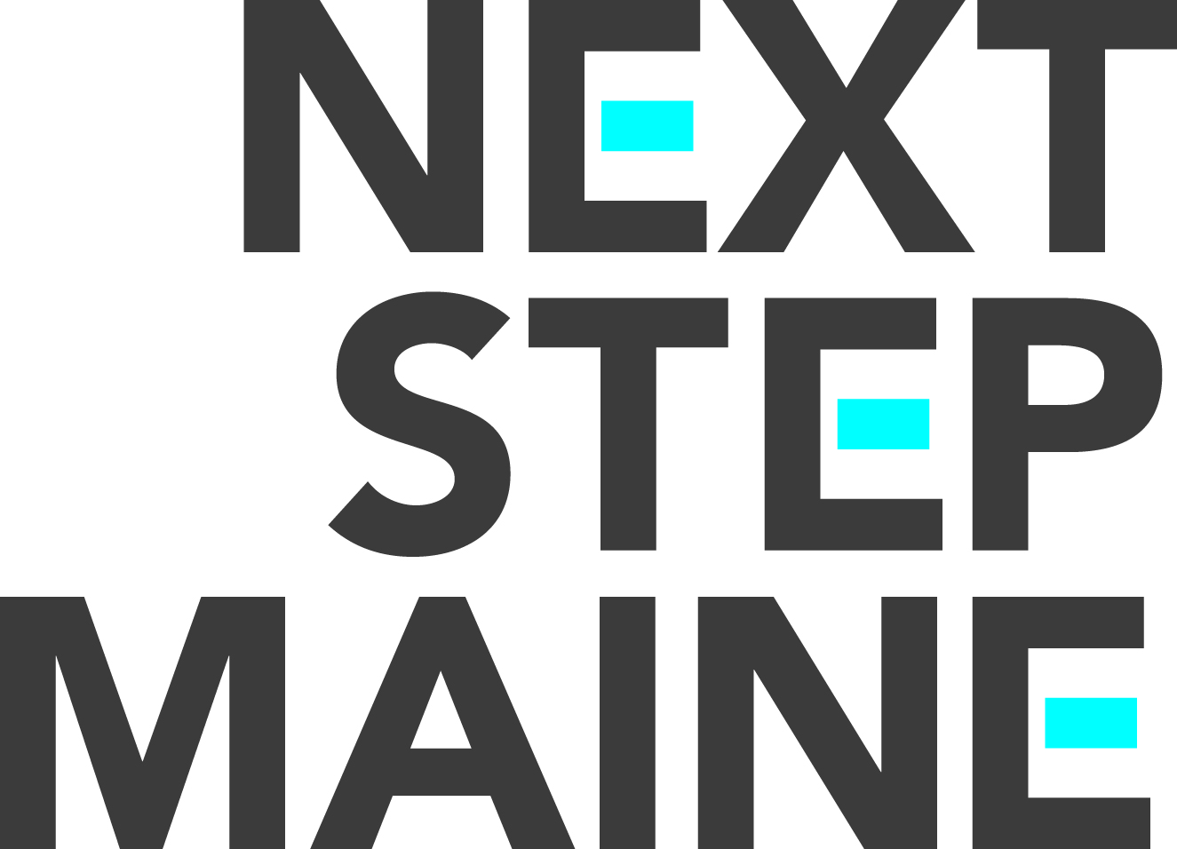
College Kids Aren’t Always Kids…

Slide 49
Notes:
Add MDOE & NVME

Slide 50


Slide 51


Slide 52


Slide 53


Slide 54
109,000

Slide 55





Slide 56




Slide 57



Slide 58
Unleash the Potential of Communities & Economic Sectors

Slide 59



Slide 61


“It’s déjà vu all over again.”

Slide 62

Assets and Advantages
Still $8.5 billion industry even after $1 billion decline!
Maine is within a one day drive of 70 million of the wealthiest people on the planet
Nearly half of state’s forestland (9 million acres) certified sustainable
The majority of Maine’s
forest lands are privately owned
Notes:
We have assets and advantages

Slide 63





Sweden
Finland
Other Regions Have Developed a Vision For Their Forest Products Sector!
Notes:
Time for a plan of some sort, various models are out there.

Slide 64









Unique Collaboration
Notes:
Diversity of the collaboration is one of our great strengths
FOR/Maine is Industry Led with University of Maine and other partners
40 industry + members
Support from Maine Forest Products Council, Maine Woodland Owners, Professional Logging Contractors of Maine, Biobased Maine, the Maine Development Foundation
Partners include University of Maine, Maine Technology Institute, Maine International Trade Center, Maine and Co., Maine Congressional Delegation
Key input from state agencies
Funding from US EDA, USDA, and Maine Timberlands Charitable Trust

Slide 65

Notes:
How are we organized?
Subcommittees focused on specific scopes of work, each working with consultants to ask the right questions
Executive committee including subcommittee chairs to bring it all together
We are now in synthesis and looking toward implementation
Its an exciting time, we have the date and now what do we need to do

Slide 66



Signs of Investment

Slide 67



Slide 68


“The future ain’t what it used to be.”
Cross Laminated Timber
“Plyscrapers”!
Bullitt Center, Seattle, WA
Brock Commons,
Vancouver BC
Notes:
The University of British Columbia's Brock Commons opened in July 2017 and is the world’s Tallest Wood Tower
A hybrid of mass timber products with concrete and steel components, the 18-story, 174-foot-tall structure was erected in less than 70 days
Bullitt Center is a commercial office building and one of the world’s greenest buildings

Slide 69


“The future ain’t what it used to be.”

Slide 70



UMaine Collaborates with Oak Ridge National Laboratory:
Additive Manufacturing with Biobased Materials
3-D Printer and Printed Yacht (below)

Slide 71


Slide 72





Consumer Demand for Biobased Products
Market for biobased materials and chemicals has reached $1B (a 28% annual increase).
2/3 of total chemicals worldwide can be produced from biobased material - over 50,000 products, a $1T annual global market.
Global demand for biobased and biodegradable plastics will rise 19% per year. Rising demand for bioplastics for food + beverages.
Notes:
BIG BRANDS COMMIT TO RENEWABLE SUPPLY CHAIN

Slide 73



Community Working Group

Slide 74
Unleash the Full Potential of Maine Leaders

Slide 75


25 Years
~1100 Leaders

Slide 76

New: ICL Leadership Intensive transfers to MDF!
25 years, 770 alumni
Increased reach, impact, engagement!

Slide 77



Slide 78



Slide 79




Slide 80




Slide 81


Slide 82




Slide 83


Slide 84


Slide 85



Slide 86






Slide 87



Slide 88
Trusted Research
Leadership
Creative Cross-Sector Partnerships

Slide 89
“If you don’t know
where you are going,
you’ll end up someplace else.”
-- Yogi Berra

Slide 91


